Slide 1

Microsoft Fabric
Integrated Analytics Solutions in the Age of AI
Notes:
Introduce the Microsoft team to the customer

Slide 2


Data Engineering

Slide 3
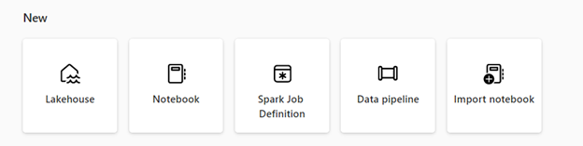
Data Engineering in Fabric
Microsoft Fabric provides various data engineering capabilities to ensure that your data is easily accessible, well-organized, and of high-quality. From the data engineering homepage, you can:
Create and manage your data using a lakehouse
Design pipelines to copy data into your lakehouse
Use Spark job definitions to submit batch/streaming job to Spark cluster
Use notebooks to write code for data ingestion, preparation, and transformation
Notes:
Reflex is a system of detection.
It lets your business’s subject-matter experts monitor all of your data in the Microsoft Cloud.
They can use the easy, familiar experiences of Fabric to model that data, define the changing conditions in the data they want to look for
They set up real-time triggers that act on insights.
And Reflex sends notifications, kicks off workflows, or even reaches directly into operational systems to optimize how the business runs

Slide 4
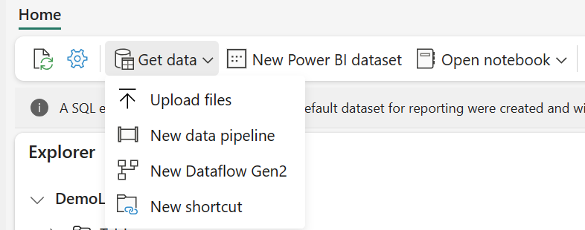
Data Ingestion Approaches in Fabric
Microsoft Fabric provides various options to ingest data into the OneLake:
Upload data
Using Data Pipelines to ingest Data
Using Dataflow Gen2 to Ingest data
Using Shortcuts to reference data without copying it
Using Notebooks to write code for data ingestion, preparation, and transformation
Using OneLake File Explorer to Sync files
Notes:
Reflex is a system of detection.
It lets your business’s subject-matter experts monitor all of your data in the Microsoft Cloud.
They can use the easy, familiar experiences of Fabric to model that data, define the changing conditions in the data they want to look for
They set up real-time triggers that act on insights.
And Reflex sends notifications, kicks off workflows, or even reaches directly into operational systems to optimize how the business runs

Slide 5
Demo: Data Engineering

